Slide 1


Bellabeat: How can a wellness company play it smart?
Presented By: Antasha D. Lamb

Slide 2
Agenda
Discuss Stakeholders
Address problem
Explore distance and calories amongst various active groups
Continue to explore active groups
Explore steps and heart health
Understanding the impact of BMI
Final remarks and recommendations
References

Slide 3
Stakeholders:
Urška Sršen: Bellabeat co founder and Chief Creative Officer
Sando Mur: Mathematician and Bellabeat cofounder; key member of the Bellabeat executive team
Bellabeat Marketing Analytics Team

Slide 4
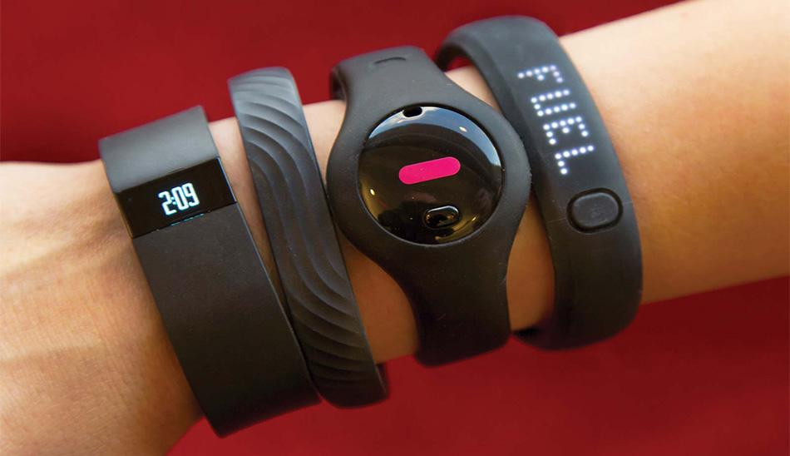
Analyzing the Problem
1. What recent trends are emerging in smart device usage?
2. How can these trends be leveraged to cater to Bellabeat customers effectively?
3. In what ways can these insights shape and enhance Bellabeat's marketing strategies?

Slide 5
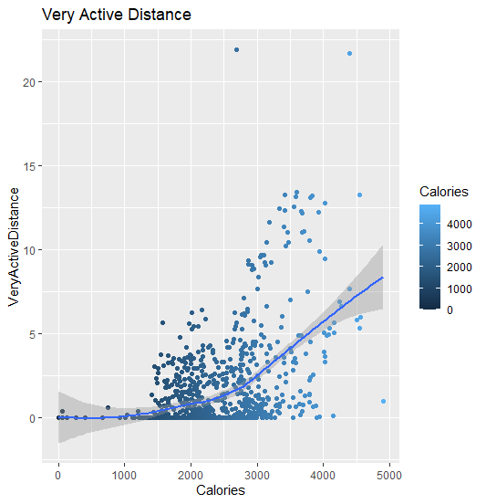
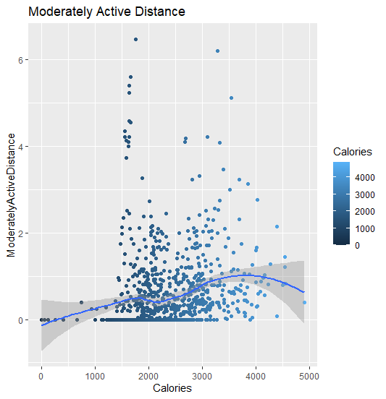

Distance and Calories associated with levels of activity
Notes:
The initial group of charts I wish to elaborate on pertains to the relationship between different levels of activity, total distance travelled, and total calories expended. The Daily Activity Table comprises 15 columns, and I chose to examine the correlation between active minutes, varying distances, and the actual calories burned. The dataset encompasses 33 participants, with a cumulative total of 4,900 calories reported as burned. The overall distance traversed amounts to 28.03 units.
The total count of steps recorded is 36,019. The maximum distances associated with different levels of activity are as follows: Very Active demonstrates a strong positive correlation with 56% of the distance covered, while Moderately Active exhibits a weak correlation, accounting for 17% of the distance travelled.

Slide 6
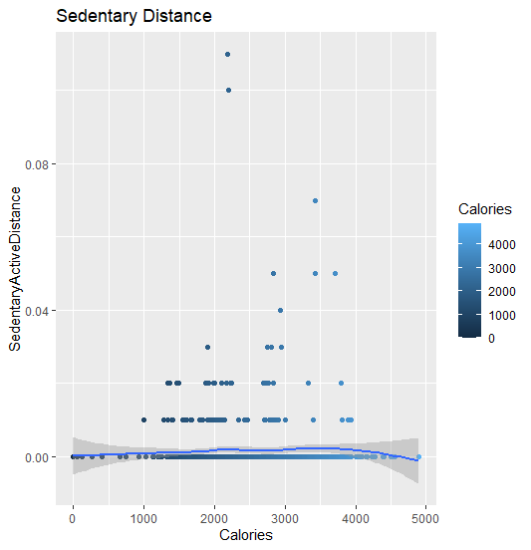
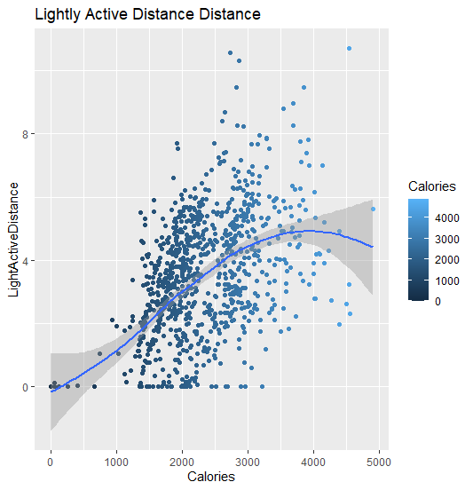
Distance and Calories associated with levels of activity
Notes:
The subsequent slide indicates a lack of correlation between the sedentary active group, distance, and calories burned. This may be attributed to the group's coverage of only 3% of the reported distance travelled. In contrast, the lightly active group exhibited a correlation between the distance travelled and the calories expended, having covered 27% of the reported distance.

Slide 7
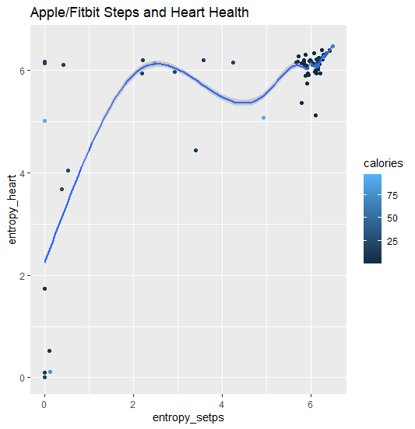
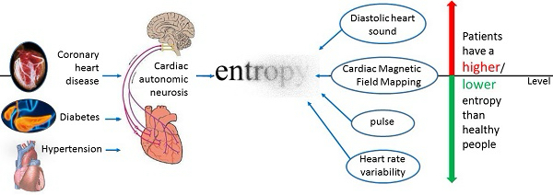
Relationship Between Steps and Heart Health
Notes:
This data shows the correlation between entropy heart rates and entropy steps. Heart rate variability is the variation of the time interval between consecutive heartbeats. Entropy is a commonly used tool to describe the regularity of data sets. This chart shows a positive relationship between the entropy heart rate and physical activity first at about 3 intense steps and a raise in heart rate to 6; and then again at about 6 intense steps with a entropy rise to 7. Sedentary people have high entropy values at rest, which decrease with moderate physical activity. People who exercise regularly tend to retain their entropy value at rest or increase their entropy.
The data presented illustrates the relationship between entropy in heart rates and entropy in steps. Heart rate variability refers to the fluctuation in the time intervals between successive heartbeats. Entropy serves as a widely utilized metric for characterizing the regularity of data sets. The chart indicates a positive correlation between entropy in heart rates and levels of physical activity, first observed at approximately three intense steps, accompanied by an increase in heart rate to six, and again noted at around six intense steps with a corresponding rise in entropy to seven. Individuals with sedentary lifestyles exhibit elevated entropy values while at rest, which tend to decrease with moderate exercise. Conversely, those who engage in regular physical activity often maintain or even increase their entropy values while at rest.

Slide 8
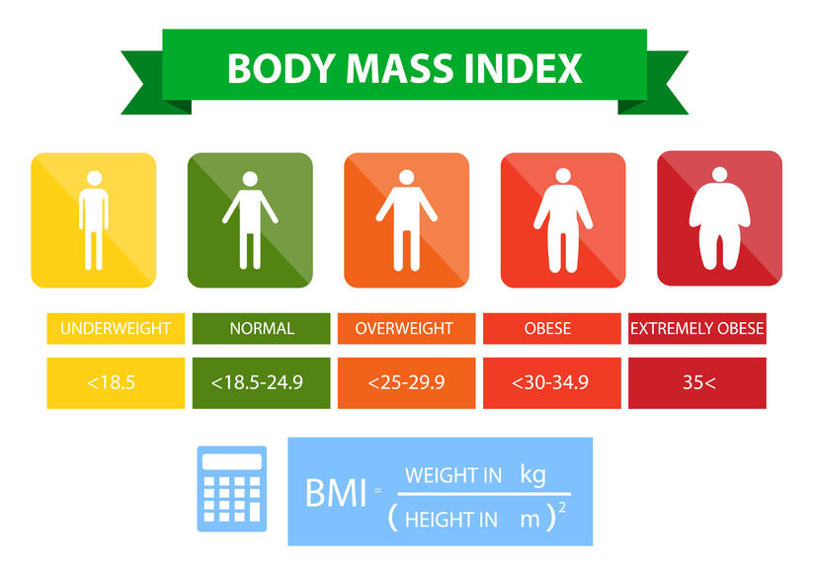
Understanding BMI Impact
BMI is a screening tool used by health care providers to evaluate a patient's weight category based on their height and weight. While BMI is not the only measure of health, it is one of the tools a health care provider will use to assess your overall health.
BMI categories include:
Underweight(BMI of 18.5 kg/m2 or less)
Normal Weight(BMI of 18.5-24.9 kg/m2)
Overweight(BMI of 25-29.9 kg/m2)
Obesity(BMI of 30 kg/m2 or greater)
Notes:
Next, I would like to examine the implications of Body Mass Index (BMI). BMI serves as a metric to assess whether an individual maintains a healthy weight. It is calculated using a person's weight in relation to their height. Typically, a higher BMI indicates a greater amount of body fat. BMI is frequently employed as a screening instrument to evaluate the potential risk of health issues, including heart disease, diabetes, and cancer, associated with one's weight.
The classifications are as follows: Underweight: a BMI of less than 18.5. Optimal range: a BMI from 18.5 to 24.9. Overweight: a BMI between 25 and 29.9. Class I obesity: a BMI ranging from 30 to 34.9. Class II obesity: a BMI from 35 to 39.9. Class III obesity: a BMI exceeding 40.

Slide 9
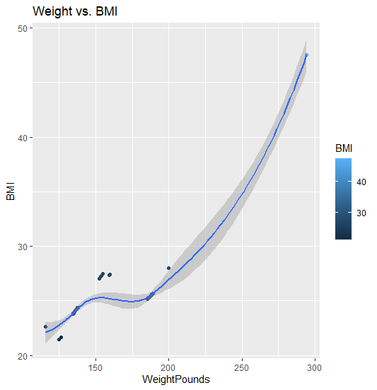
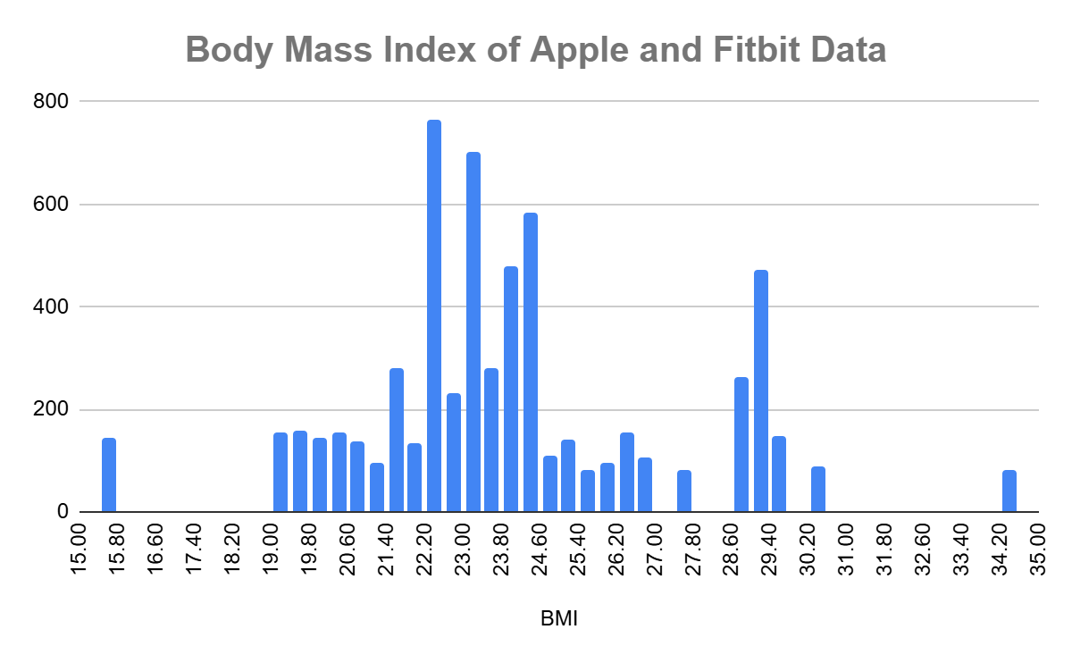
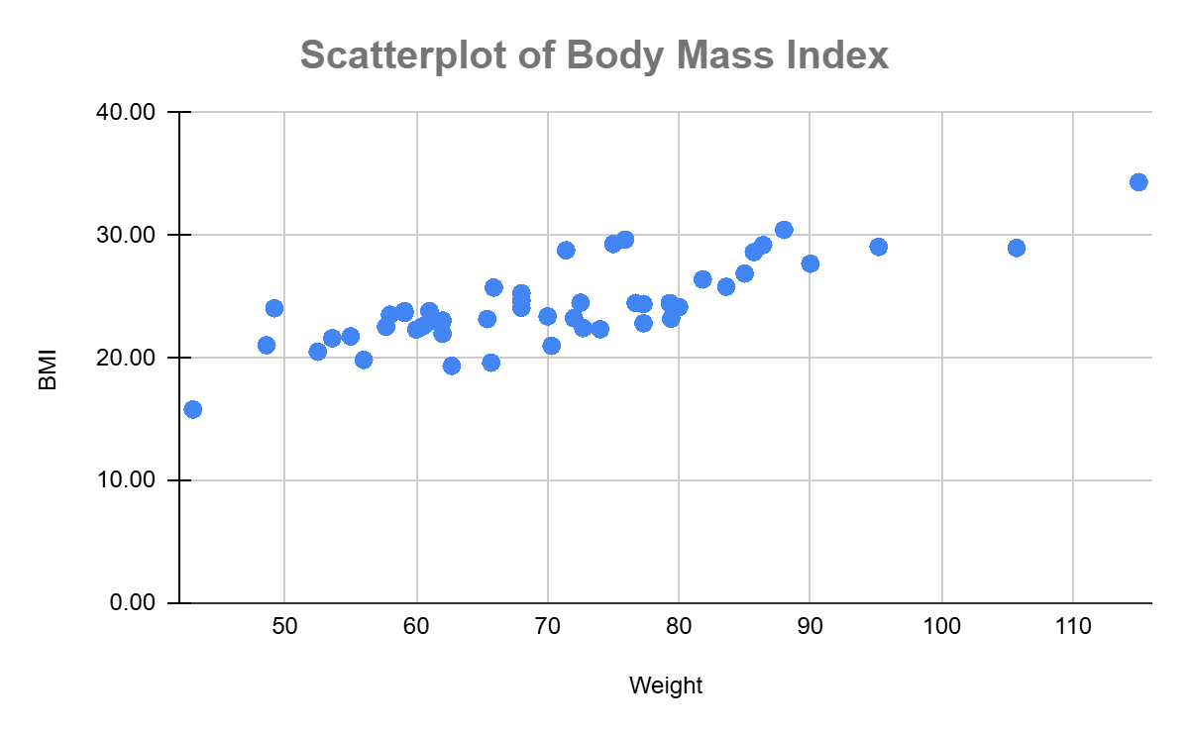
Notes:
The data presented on the left from the Fitbit dataset indicates a positive correlation for most of the sample, whose Body Mass Index (BMI) values fall within the normal range. Nonetheless, a minor proportion of participants are categorized as overweight, as evidenced by the data points situated above the trend line, while an even smaller fraction of participants is classified as underweight, represented by the points located below the trend line.
The information derived from the Apple Watch/Fitbit dataset displayed on the right illustrates the following: The histogram located in the upper section of the screen reveals a substantial distribution of participants within the normal weight range, alongside a few outliers categorized as underweight and overweight, with a minor percentage classified as obese. The scatterplot in the bottom right corner indicates a positive correlation between weight and body mass index (BMI). This suggests that the majority of adults aged 18 to 56 aspire to maintain a healthy lifestyle.

Slide 10
Recommendations
The ideal target market consists of highly active individuals. This demographic has demonstrated ongoing engagement, yielding impressive outcomes based on the data. Bellabeat could introduce a personalized goal-setting system for each user, encouraging them to increase their movement and distance covered to burn calories, achieve a healthy weight, and maintain an optimal heart rate.
Consider reimagining the Ivy by creating an Ivy 2.0 that enhances its capabilities for tracking steps, exercise, body mass index (BMI), sleep patterns, and heart rate notifications. It's crucial to maintain all current features while encouraging a spirit of healthy competition among users. Furthermore, adding a display that regularly shows total steps, distance, heart rate, menstrual cycle tracking, mood, BMI, and healthy sleep habits could provide significant benefits. Encouraging healthy behaviors and setting up alerts for when activity levels fall below the normal range would also be valuable improvements.
To summarize, the current price is set at $380.00 in relation to the existing market conditions. Fitbit devices are available at prices ranging from $95 to $180, while Apple Watches are priced between $99 and $799. Significantly, Apple holds a greater market share than many competitors. It is advisable for Bellabeat to create the Ivy 2.0, which should feature a sturdy and comfortable band, and be priced 25% lower than the current price. Marketing initiatives should begin three months before Christmas and ramp up throughout December.
Bellabeat can integrate Body Mass Index monitoring. This type of monitoring by allowing users to enter their weight and height into the device or application; allowing continuous monitoring, while encouraging a healthy habits, such as diet,sleep, and exercise routines
Notes:
The ideal target market consists of highly active individuals. This demographic has demonstrated ongoing engagement, yielding impressive outcomes based on the data. Bellabeat could introduce a personalized goal-setting system for each user, encouraging them to increase their movement and distance covered to burn calories, achieve a healthy weight, and maintain an optimal heart rate.
Bellabeat offers the capability to monitor Body Mass Index. This feature enables users to input their weight and height into the device or app, facilitating ongoing tracking while promoting healthy habits like diet, sleep, and exercise routines.
Consider reimagining the Ivy by creating an Ivy 2.0 that enhances its capabilities for tracking steps, exercise, body mass index (BMI), sleep patterns, and heart rate notifications. It's crucial to maintain all current features while encouraging a spirit of healthy competition among users. Furthermore, adding a display that regularly shows total steps, distance, heart rate, menstrual cycle tracking, mood, BMI, and healthy sleep habits could provide significant benefits. Encouraging healthy behaviors and setting up alerts for when activity levels fall below the normal range would also be valuable improvements.
To summarize, the current price is set at $380.00 in relation to the existing market conditions. Fitbit devices are available at prices ranging from $95 to $180, while Apple Watches are priced between $99 and $799. Significantly, Apple holds a greater market share than many competitors. It is advisable for Bellabeat to create the Ivy 2.0, which should feature a sturdy and comfortable band, and be priced 25% lower than the current price. Marketing initiatives should begin three months before Christmas and ramp up throughout December.

Slide 11
References
Click here for Google Document
https://www.kaggle.com/datasets/arashnic/fitbit
https://www.kaggle.com/datasets/aleespinosa/apple-watch-and-fitbit-data
https://www.cdc.gov/nchs/products/databriefs/db443.htm
https://www.cancer.org/cancer/risk-prevention/diet-physical-activity/body-weight-and-cancer-risk/body-mass-index-bmi-calculator.html

